Slide 1
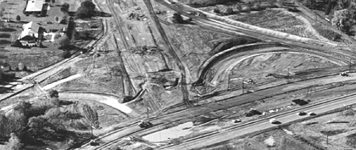
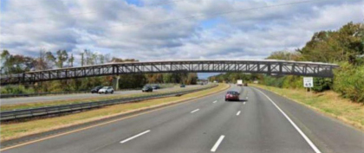
Johnson Trolley Line Trail
A bridge to connect people and communities
Notes:
Hello, thank you so much for you time today to discuss a project that will be complete transformative to the Capital County.
https://docs.google.com/document/d/1AF5dMfJEuthlQmRfR8yTe3fKht8W_zVGhf8x-CLu40w/edit?usp=sharing - Outline here
Design guidance for slidedeck:
Font: Raleway
Title: 33 + Bold
Body: Raleway

Slide 2
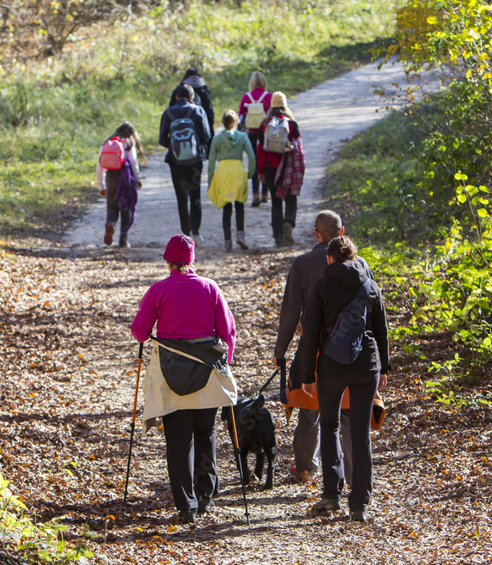
Introductions
Tim Brill, Central Jersey Project Manager, New Jersey Conservation Foundation
Leslie Floyd, Planning Director, Mercer County
Cheryl Kastrenakes, Executive Director, Greater Mercer Transportation Management Association
Paul Larson, Chair, Lawrence Township Trails, Open Space and Stewardship Committee
Shawn Megill Legendre, Manager, Regional Trails Program, Delaware Valley Regional Planning Commission
Kevin Nerwinski, Municipal Manager, Lawrence Township
Jim Parvesse, Municipal Engineer, Lawrence Township
Sonia Szczesna, Director, Active Transportation, Tri-State Transportation Campaign & Circuit Trails Coalition NJ Vice-Chair
Becky Taylor, Co-President, Lawrence Hopewell Trail
Dennis Waters, Lawrence Township Historian & Resident
Johnson Trolley Line Trail

Slide 3
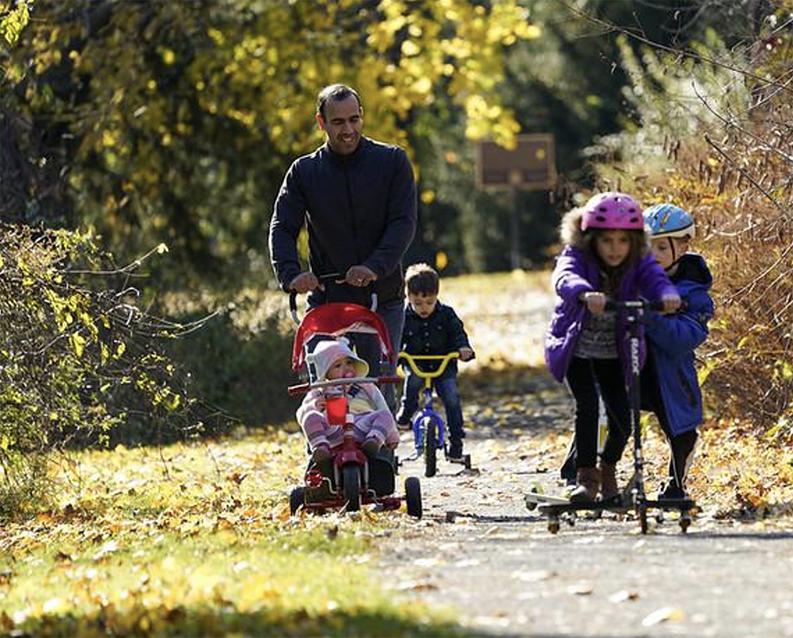
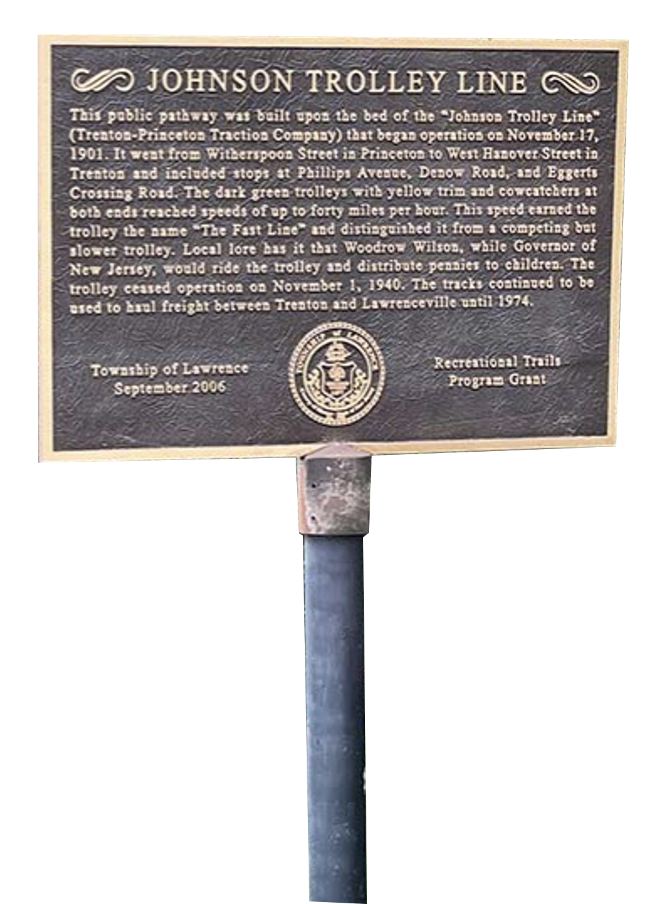
Today’s discussion
Time is now to address I-295 challenges
Safe trail system are needed to connect people & communities
Biking and walking bridge is the perfect solution
Benefits - locally and regionally
NJDOT endorsement, support are key
Johnson Trolley Line Trail

Slide 4
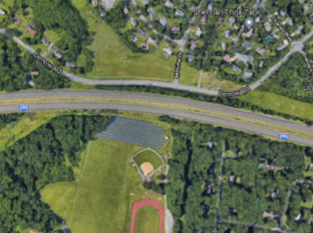
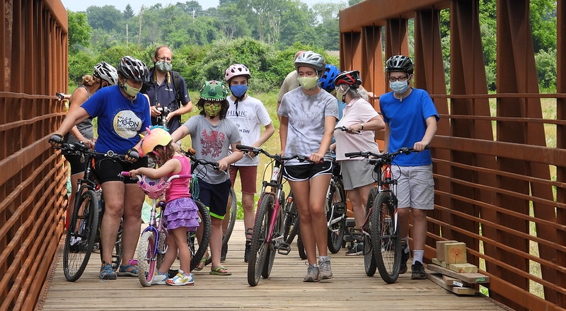
A connected future
Via a walking and biking bridge
For both sides of Lawrence Township
For communities north and south through Mercer County
Positioning of bridge span marked in red
Johnson Trolley Line Trail
Notes:
Today's discussion is about a proposed biking and walking bridge over I-295, connecting northern and southern Lawrence Township via the Johnson Trolley Line, from the Lawrence Hopewell Trail in northern Lawrence through Rider University in the southern
The interstate is one of the biggest barriers to moving people throughout Lawrence Township.

Slide 5
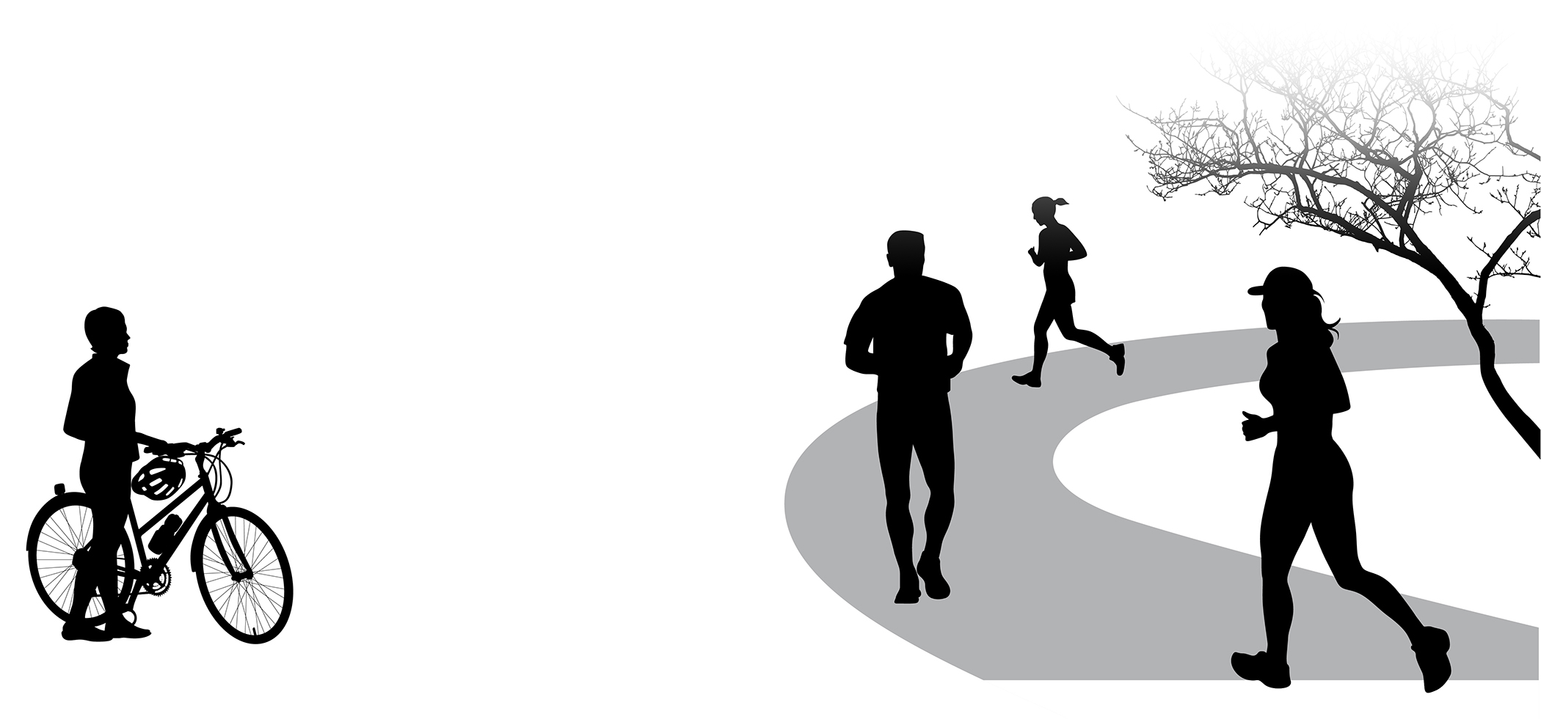
Time to act is now
Confluence of trends and events
Covid explosion
Outdoor engagement at all-time high
Surging passion for diversity, equity & inclusion
Soaring popularity of trails for recreation & transportation
Recent progress, upcoming promise
Mercer County commitment to bridge
Rider University buy-in
Infrastructure, equity funding largess
Endorsements, support pouring in
Johnson Trolley Line Trail

Slide 6
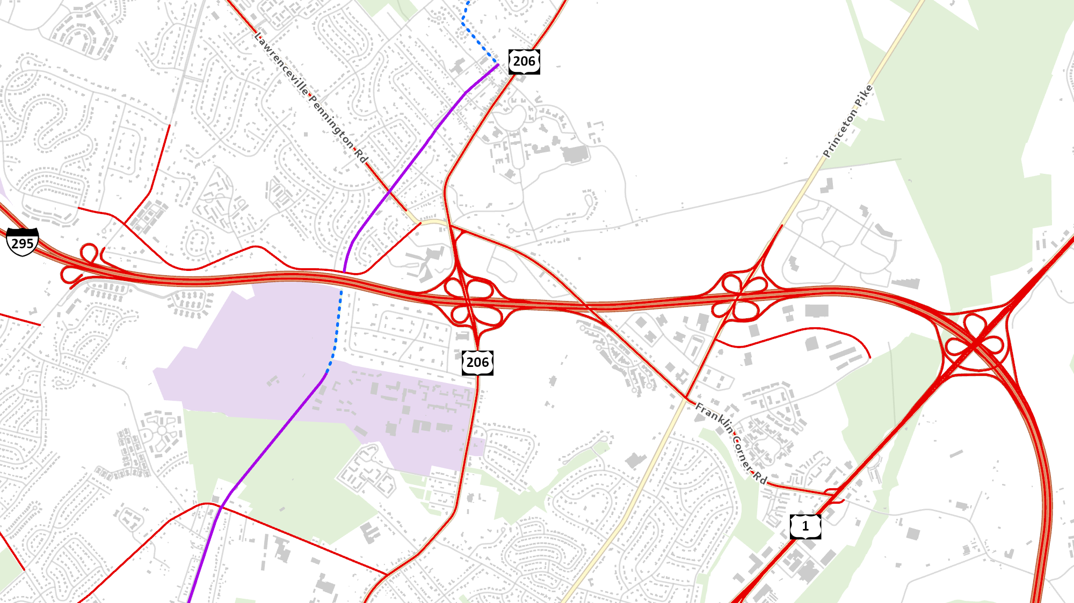
4 Interchanges for Motor vehicle crossings; 0 for walkers & bikers
New bridge welcomes walkers & bikers
Johnson Trolley Line Trail
Notes:
ANIMATED SLIDE
https://www.dvrpc.org/webmaps/bikestress/
You can see from the level of stress analysis that the interstate is a barrier to movement.
Data point - can we figure out the population on either side of the interstate → does this divide the county population-wise?
Visual: Map showing how many vehicular interchanges vs. bicycle/pedestrian crossings around I-295
Reed Road
Franklin Corner Road
D&R Canal Tow Path
Youngs Road
DVRPC Regional Sidewalk Inventory - https://walk.dvrpc.org/

Slide 7
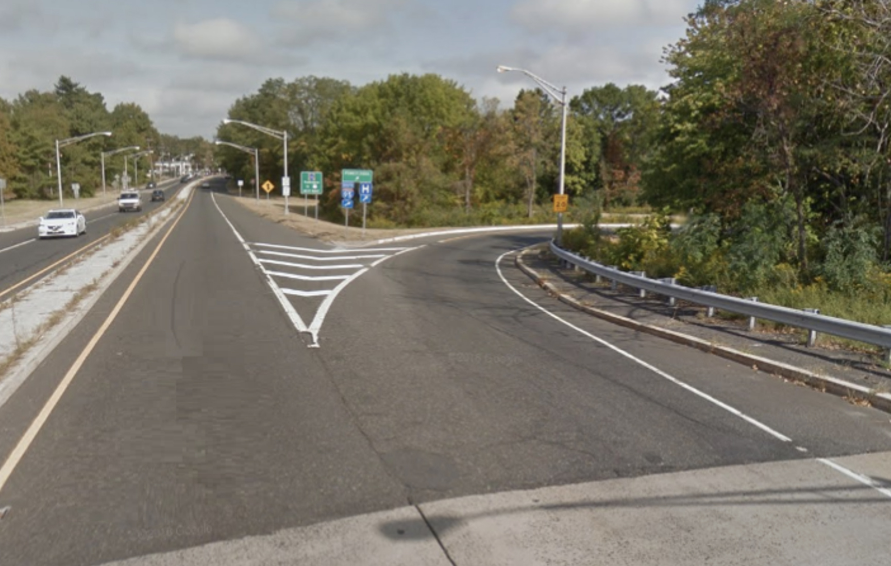
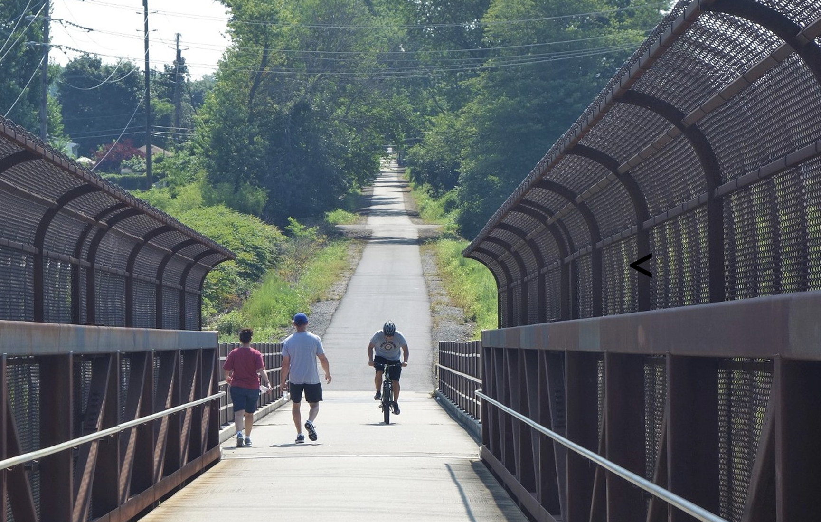
The need is great
No safe crossings in Mercer County offering connectivity
Existing Conditions: Lawrenceville Road
Trail Bridge: Middlesex Greenway
<
Unsafe & uncomfortable for most
Relaxing, safe, & suitable for most riders
Johnson Trolley Line Trail
Notes:
This infrastructure makes it difficult to for communities to access either side of 295.
Links to the amenities that exist only north of I-295, ensuring that everyone has access to them.

Slide 8
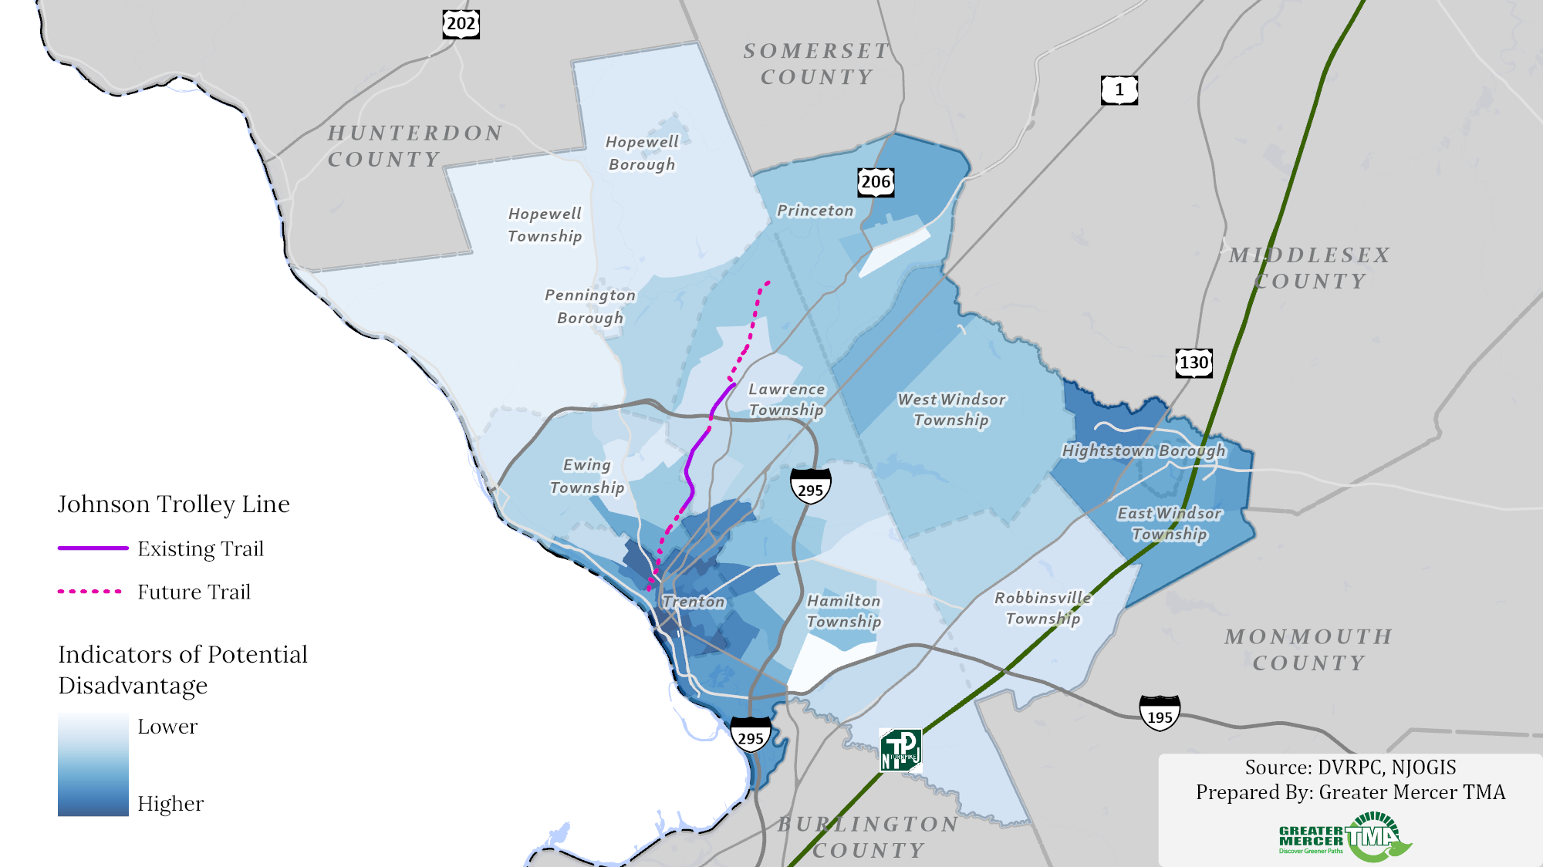
Bridge over I-295 offers the solution
Community connection via Johnson Trolley Line
Johnson Trolley Line Trail
Notes:
Today we’d like to talk to you about an opportunity to create a community connection across Mercer County along the former ROW of the Johnson Trolley Line.
This segment of trail will connect Trenton, through Ewing, to Lawrence Township and beyond - creating safe connections for children to walk to school, people to bike to work, and neighbors to be able to travel without the use of a vehicle.
As you have said in the past, “transportation is not just about cars & trucks & rails → it’s about moving people” and this project will do that and more.

Slide 9
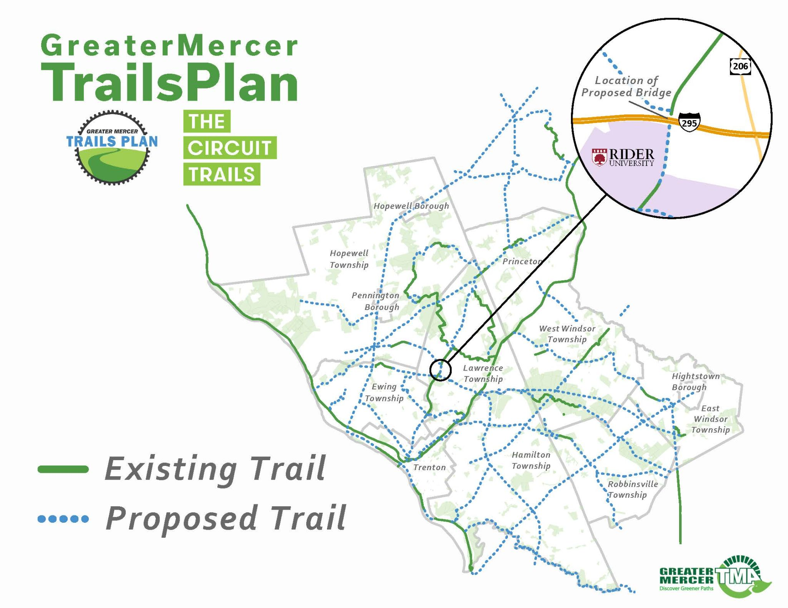
Benefits and impacts are great
Locally
Safe systems
Regional connector for the county
Creates safe routes to school
Network that connects people to jobs and other opportunities
Regionally
Priority project for Circuit Trails Coalition
Essential trunk trail of Greater Mercer Trails Plan
Johnson Trolley Line Trail

Slide 10
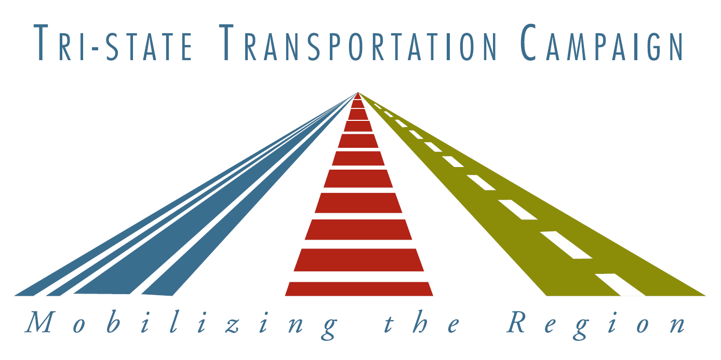
Support is widespread across the county
Notes:
In conversation with members of the community and bordering towns we’ve received really positive feedback with vocal support from a variety of organizations and communities.
Who might be missing from here???

Slide 11
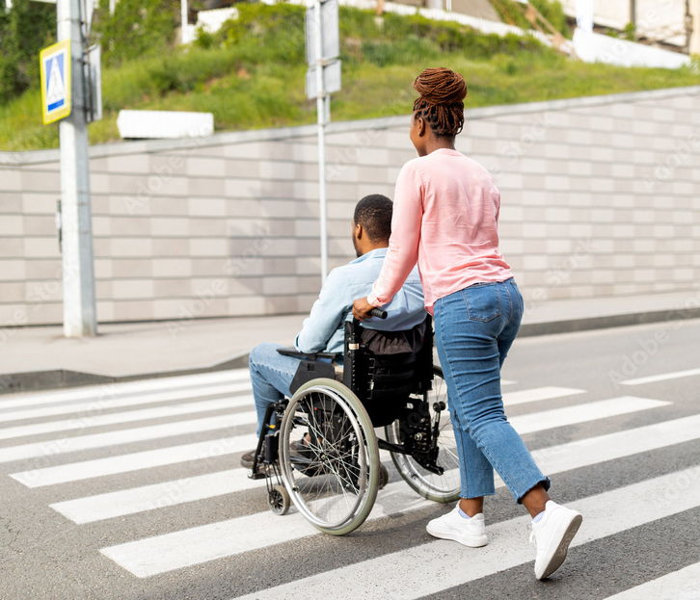
A shovel-worthy project
Promotes & Improves safety for all road users, particularly vulnerable road users
Makes streets and other transportation facilities accessible to all users and compliant with Americans with Disabilities Act
Addresses environmental impacts from stormwater runoff to greenhouse gas emissions
Regional project that benefits people throughout the County and connects multiple communities
Johnson Trolley Line Trail

Slide 12
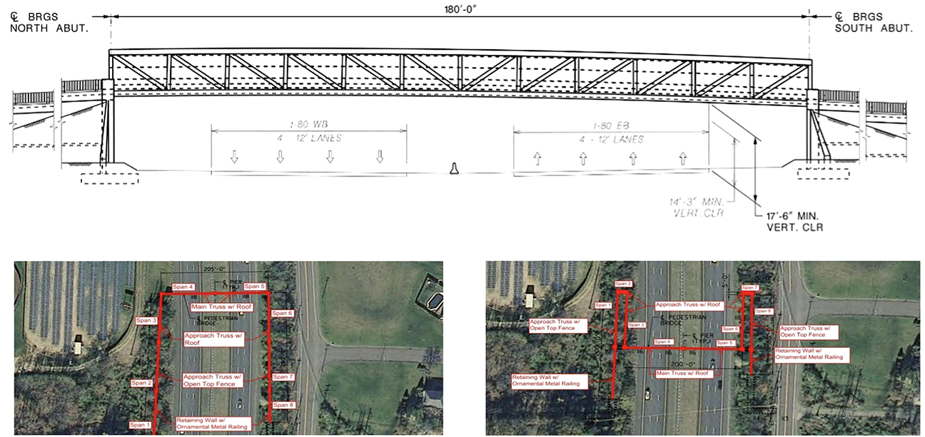
Feasibility study: Done and updated with options
Johnson Trolley Line Trail

Slide 13
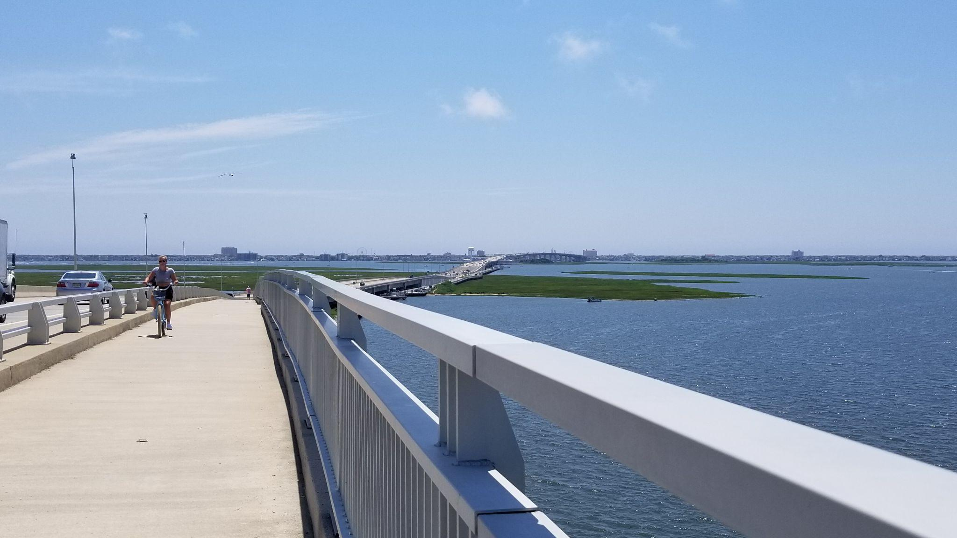
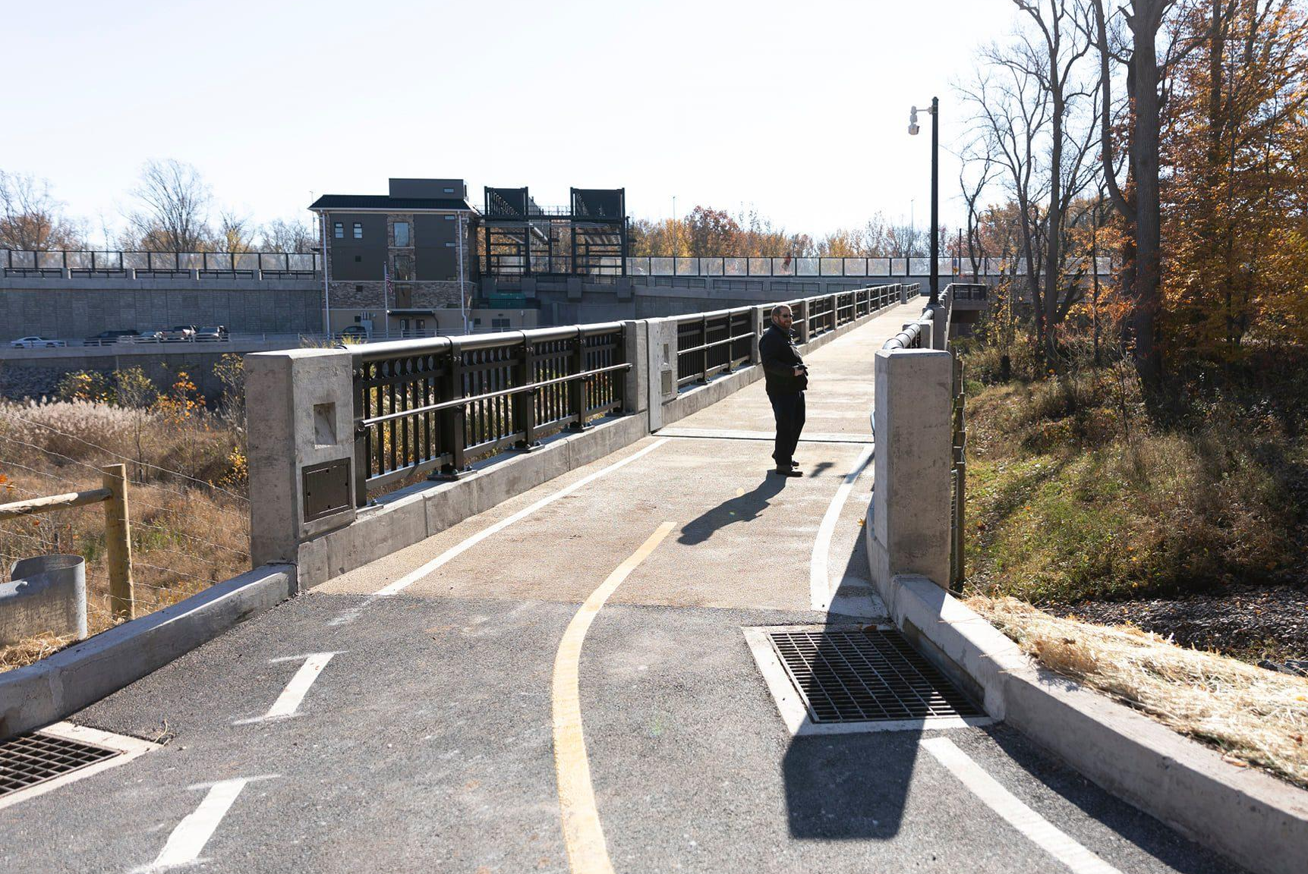
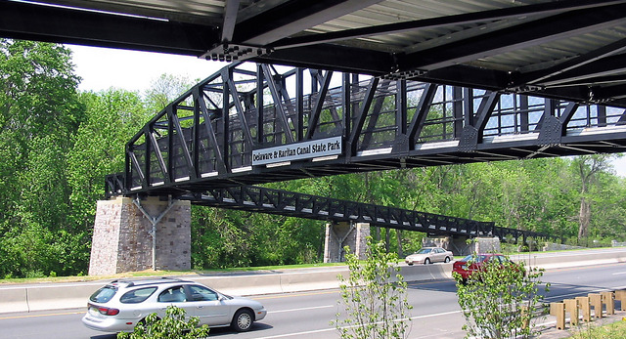
This project reflects NJDOT's values
Addressing needs of multiple users – like Scudder's Falls Bridge
Transformative transportation projects – like Ocean City Bridge
ADA & bike boom
Commitment to communities
Johnson Trolley Line Trail
Notes:
Ocean City Bridge - NJDOT
Scudder Falls - reflecting the needs of multiple users
Ocean City Bridge
Transformative transportation projects
ADA & the Bike Boom…
Commitment to Communities

Slide 14
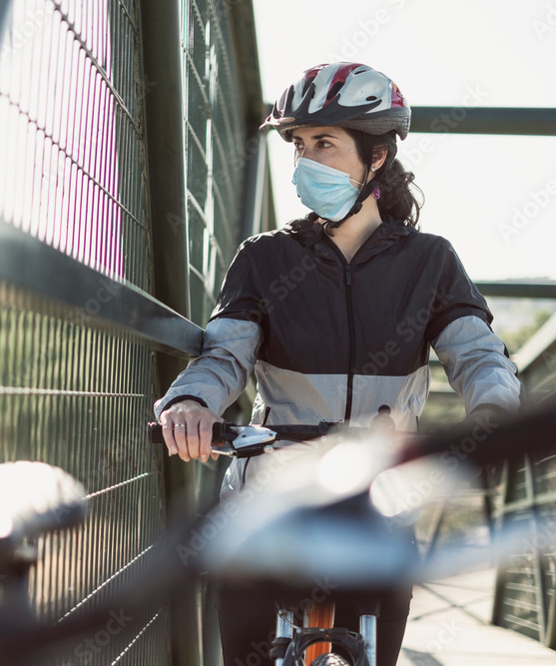
Our ask of you
Your enthusiastic, vocal, visible support for the biking and walking bridge over I-295
State acceptance of bridge maintenance responsibilities
We're ready to act but need your support!
Johnson Trolley Line Trail

Slide 15
Next steps
Further discussions within NJDOT? With Mercer County officials?
Ramps on NJDOT ROW
With 15th NJ Legislative District officials
Other?
Johnson Trolley Line Trail

